Slide 1
Neighborhood Services Environmental Code
FY 2018-19 4th Quarter
July – September 2019

Slide 2
Overview
Statistics for Environmental Code
4th Quarter Data
Trending & Forecasting
Questions

Slide 3
4th Quarter Statistics
Notes:
FY2018 FY2019 % Change
Violations Identified Proactively
9,624 11,613 20.7%
Complaints Submitted by Residents
637 429 -32.7%
Properties Contracted for Abatement
906 888 -2.0%
Citations Issued
243 337 38.7%

Slide 4
YTD Statistics
Notes:
FY2018 FY2019 % Change
Violations Identified Proactively
35,266 40,086 13.7%
Complaints Submitted by Residents
1,924 1,687 -12.3%
Properties Contracted for Abatement
3,424 1,646 -51.9%
Citations Issued
1,138 1,739 52.8%

Slide 5
Proactive Violations Identified – Previous/Current 4th Quarter Comparison
Complaints Submitted by Residents – Previous/Current 4th Quarter Comparison

Slide 6
Code Case Compliance Analysis

Slide 7
Case Management 4th Quarter Comparison
Notes:
Newest code efficiency indicator

Slide 8
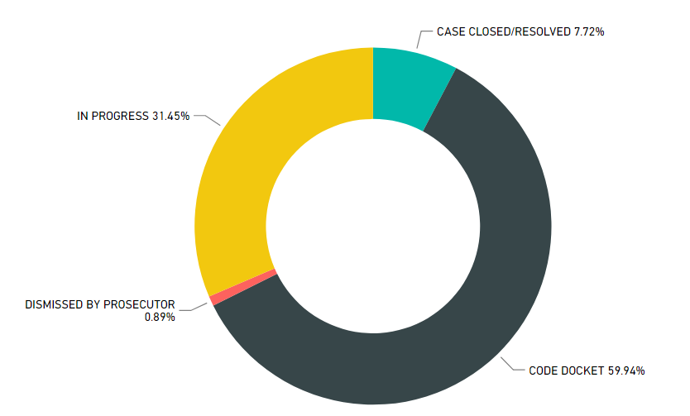
4th Quarter – Citation Dispositions
337
Citations Issued
Notes:
Dismissals from Code Inspectors are recommended, based on compliance. Prosecutors take this information into account prior to making a final judgement.

Slide 9
Top 4 Violations
Notes:
392-parking violations

Slide 10
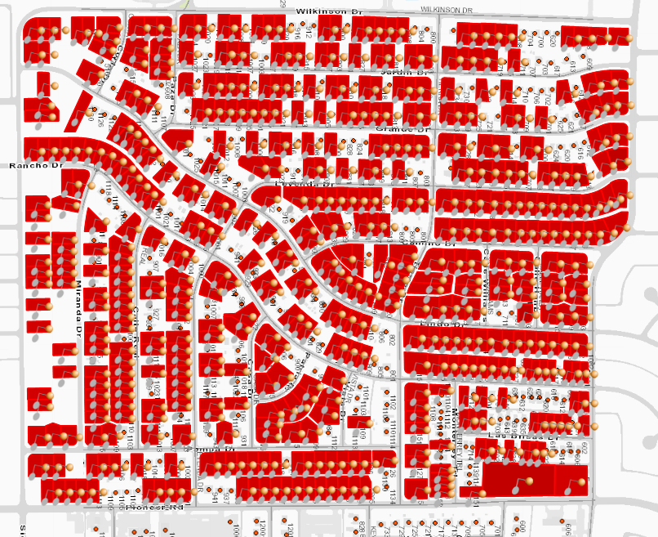
4th Quarter– Code District 8 Sweep Mesquite Park
Total Number of Code Cases: 484
Total Number of Violations: 1,199
Citations Issued: 8
Top 5 Violations:
Overhanging Limbs: 264
High Grass and Weeds: 204
Landscaping and Vegetation Maint.: 179
Nuisance Premises: 149
Trash, Junk, and Debris: 128

Slide 11
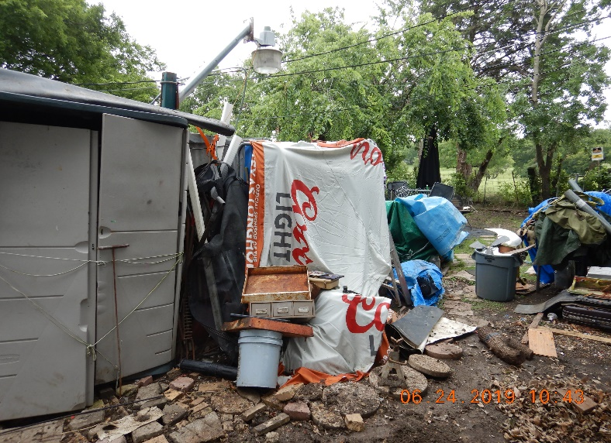
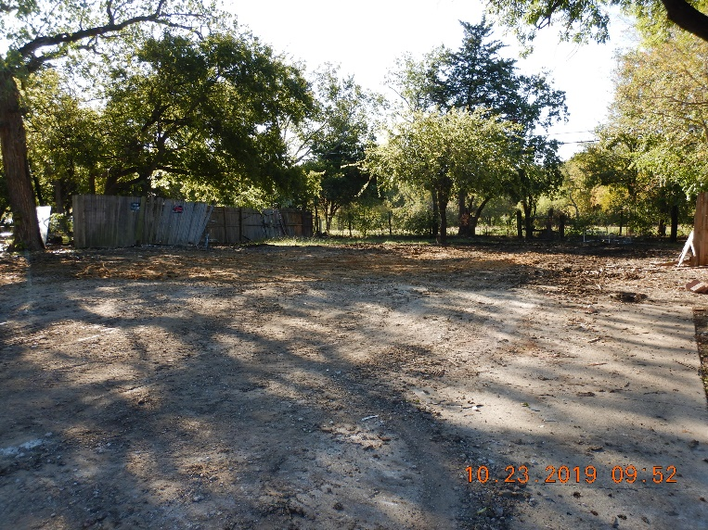
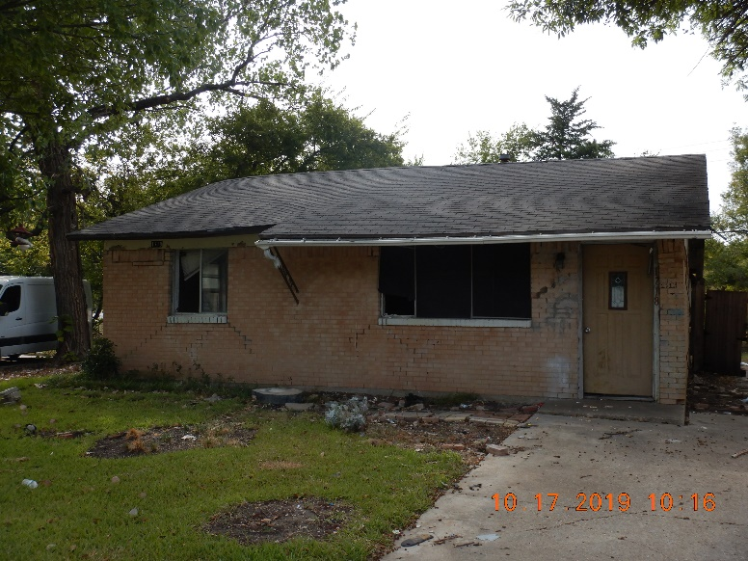
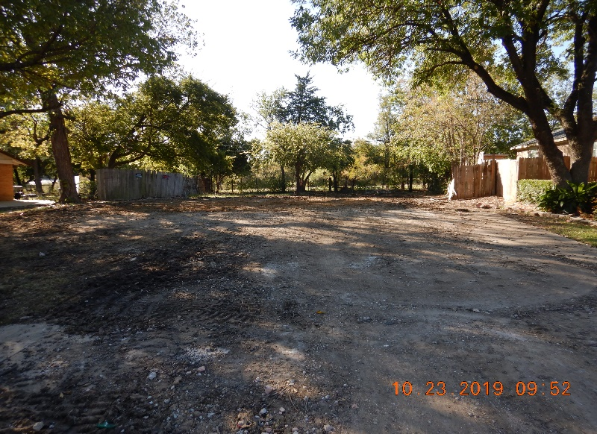
Rose Lane
Violation:
Nuisance Premises, Property Maint., Fencing, and Trash, Debris & Junk
Before
After
Notes:
Joint effort- BI and Code

Slide 12
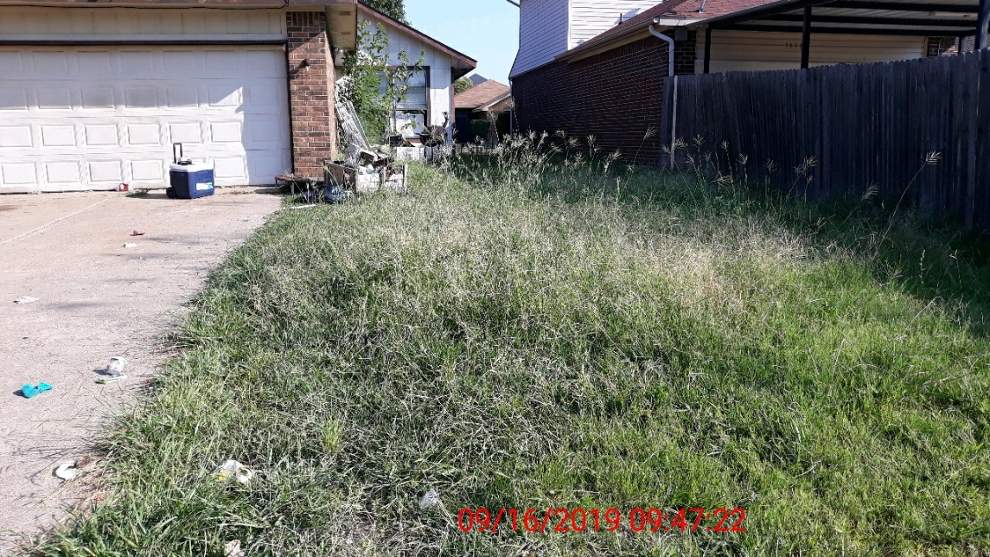
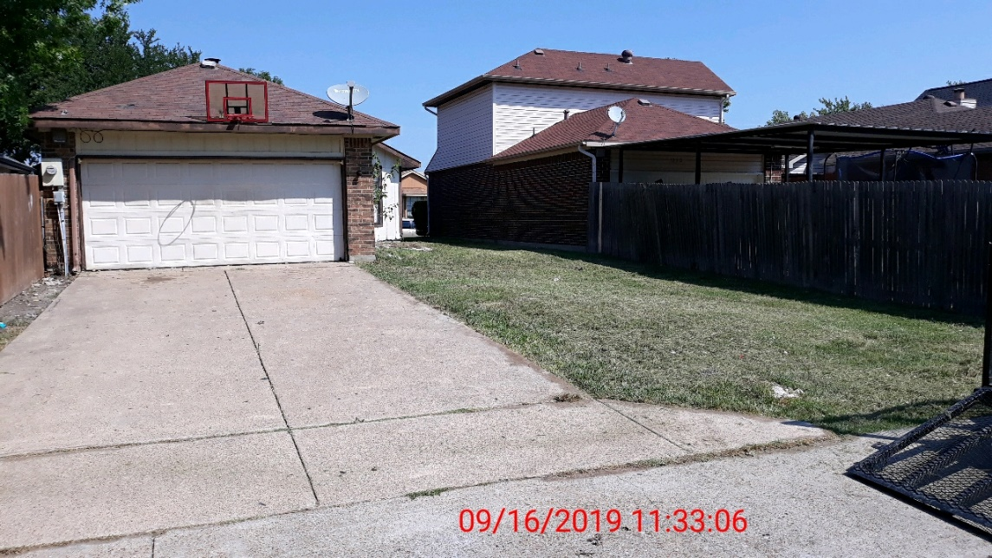
Windmill Lane
Violation:
High Grass & Weeds and Trash, Junk & Debris
Before
After

Slide 13
Code Ambassador Statistics
Behind the Numbers:
Compliance Rate – 39.27%
Volunteer Hours – 225
Recent Activity:
Continuing education for Ambassadors
Next Class set for January 30, 2020
Notes:
December Mainstream announcement – advertising on social media

Slide 14
Vacant Property Maintenance Program
4th Quarter Statistics Vacant Properties | FY2017-18 (July-Sept) | FY2018-19 (July-Sept) | % Change
Commercial | 218 | 274 | 25.7%
Residential | 315 | 312 | -1.0%
Industrial | 25 | 48 | 92.0%
Agricultural | 37 | 43 | 16.2%
Total | 598 | 680

Slide 15
Vacant Property Reoccurring Maintenance
680 total Properties have been sent Notice to Maintain, which is the first step in the Vacant Property Reoccurring Maintenance Process
148 Properties have initiated in first contract process, second step
62 Properties on the reoccurring maintenance list to be maintained every three (3) weeks, final step
We have noticed a rise in the number of properties with active permits and/or voluntary compliance.

Slide 16
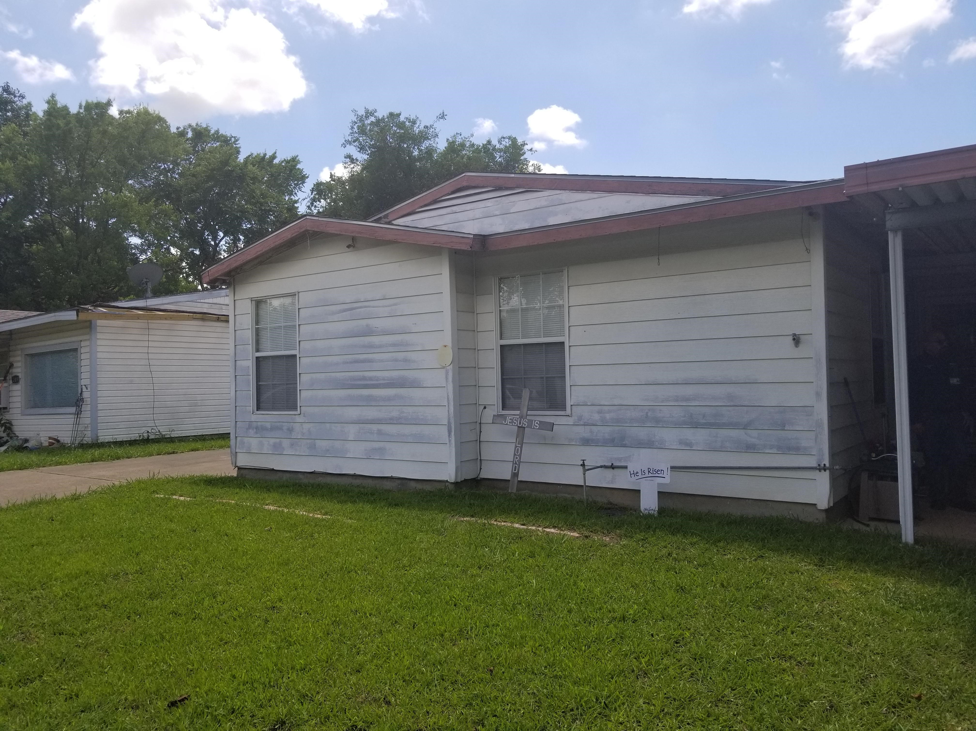
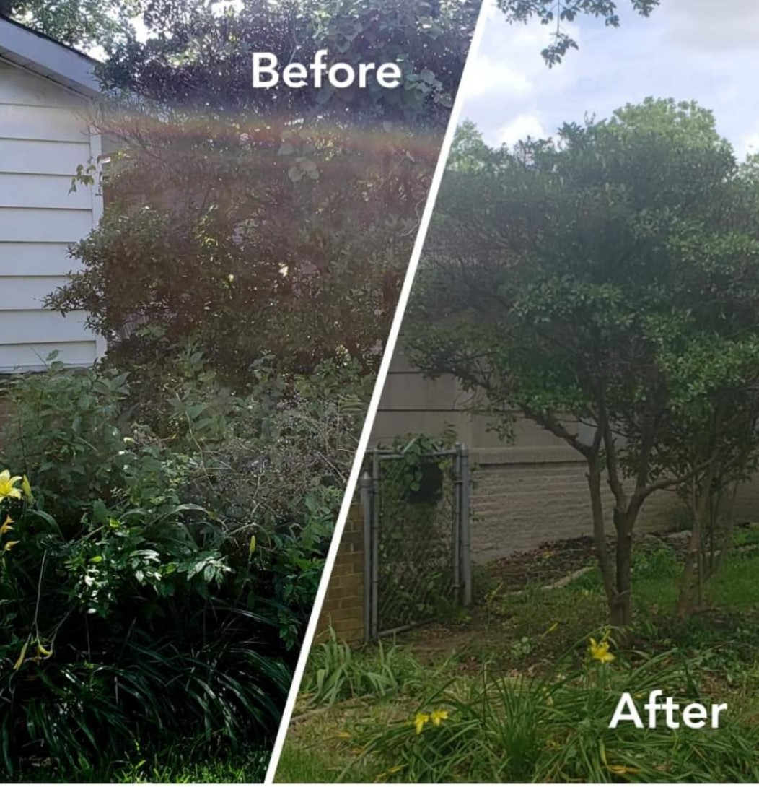
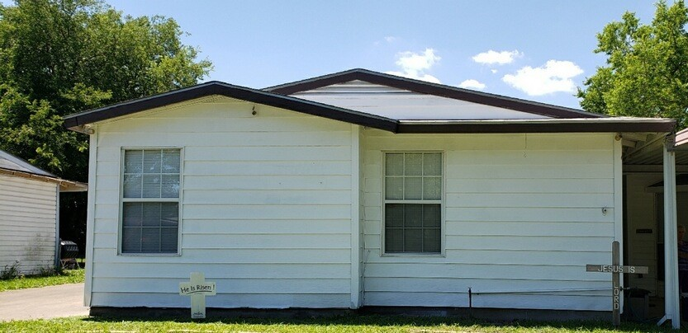
HOME Program
FY 2018-2019:
Referrals: 6
Pending: 1
Completed: 5
Before
After
Notes:
Darien Street – Rollingwood Hills -

Slide 17
Questions

